Slide 1


Slide 2


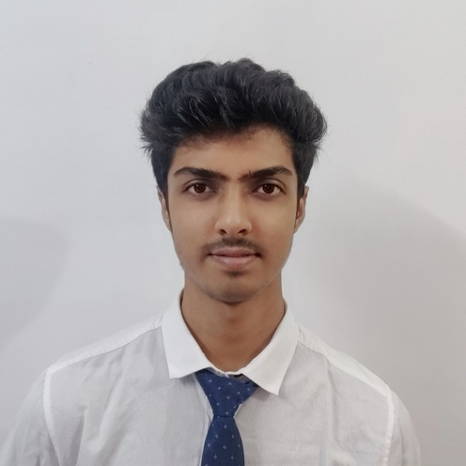

Decode Encode
Jadavpur University
Class of 2018-2022
Team Members
Manish Kumar Ghora
Chemical Engg
Ayush Patwa
Chemical Engg
Rahul Singha
Chemical Engg
Rishav Panda
Chemical Engg

Slide 3




About Us
Past Experiences / Achievements

Slide 4
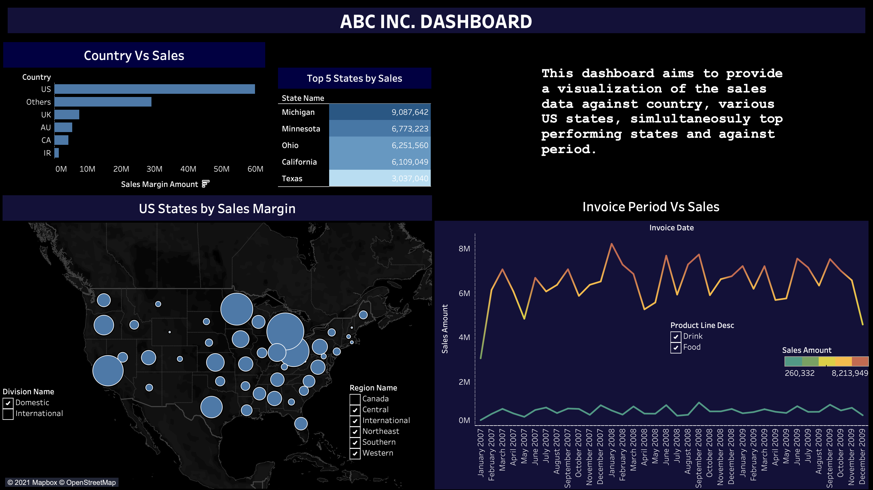
Link: Drive Link here
Dashboard
Notes:
This dashboard is reproduced from our Tableau Workbook, the file to which can be found in the link here.

Slide 5
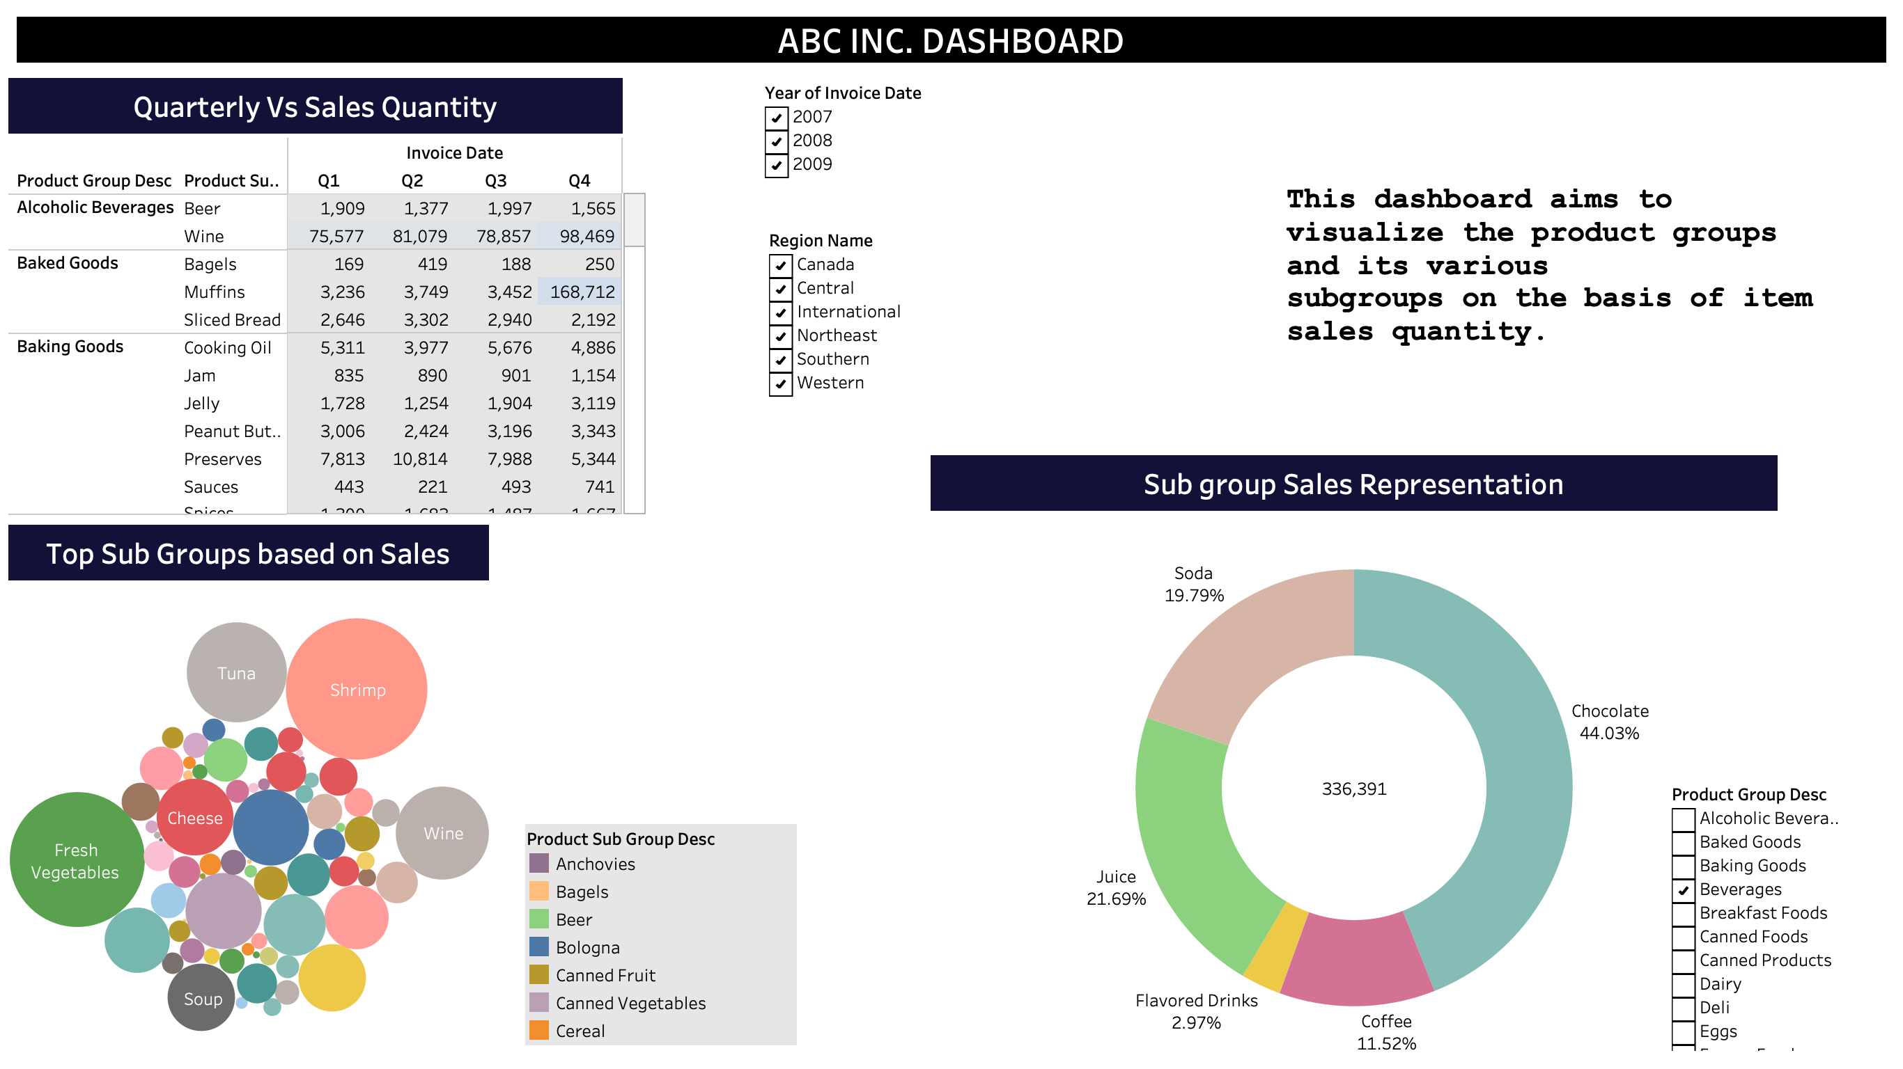
Dashboard

Slide 6

Insight #1
ABC Inc. has it’s highest consumer base in USA
With 55.89% share in overall sales.
US with highest representation -
With Michigan taking the top spot followed by Minnesota.
Note: All the images with plots & figures are reproduced from our Tableau Workbook and Dashboard, the file to which has been shared in the G-Drive Link on slide 4.
Notes:
All the images with plots and figures are reproduced from our Tableau Workbook and Dashboard, the file to which has been shared in the G-Drive Link on slide 4.

Slide 7

Insight #2
Sales Margin Amount without discount : $4,689,237.57
Sales Margin Amount with discount : $91,788,620.81
Observation: Sales Margin Amount when
discount is given is 19.5 times
of Sales Margin Amount
as compared to when no discount is given.

Slide 8
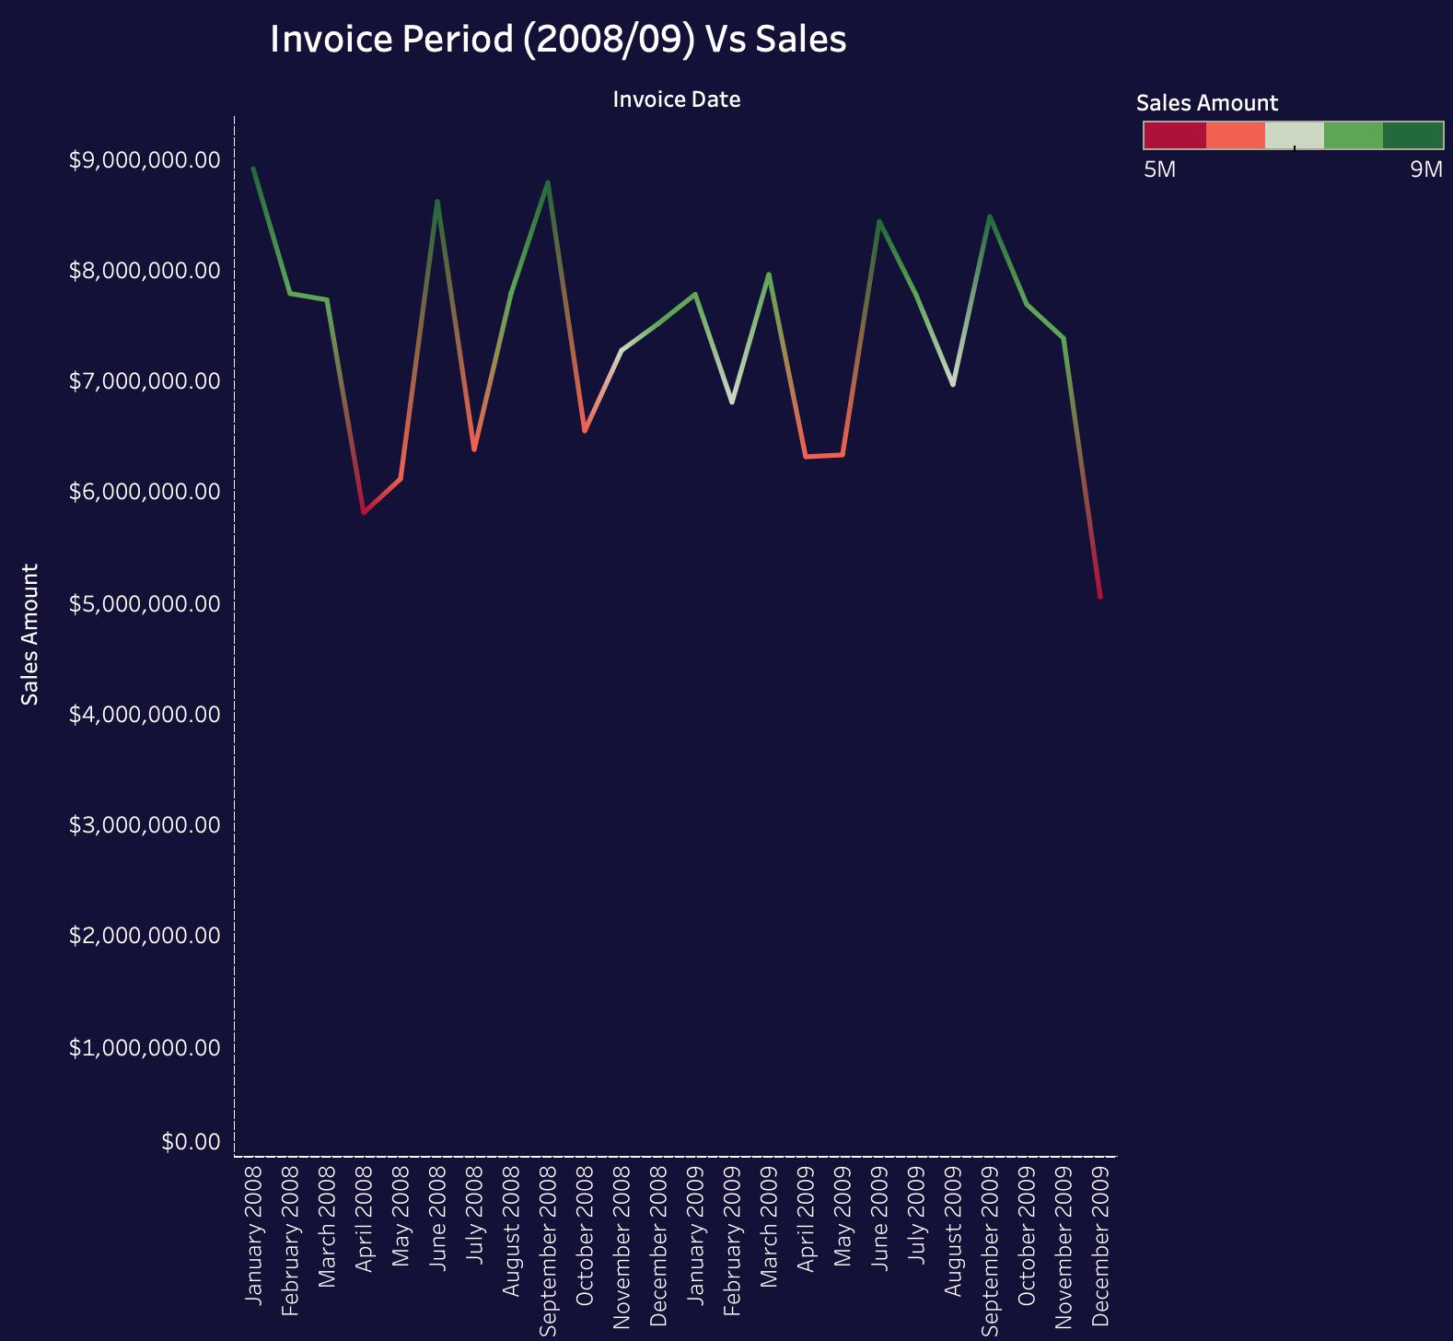
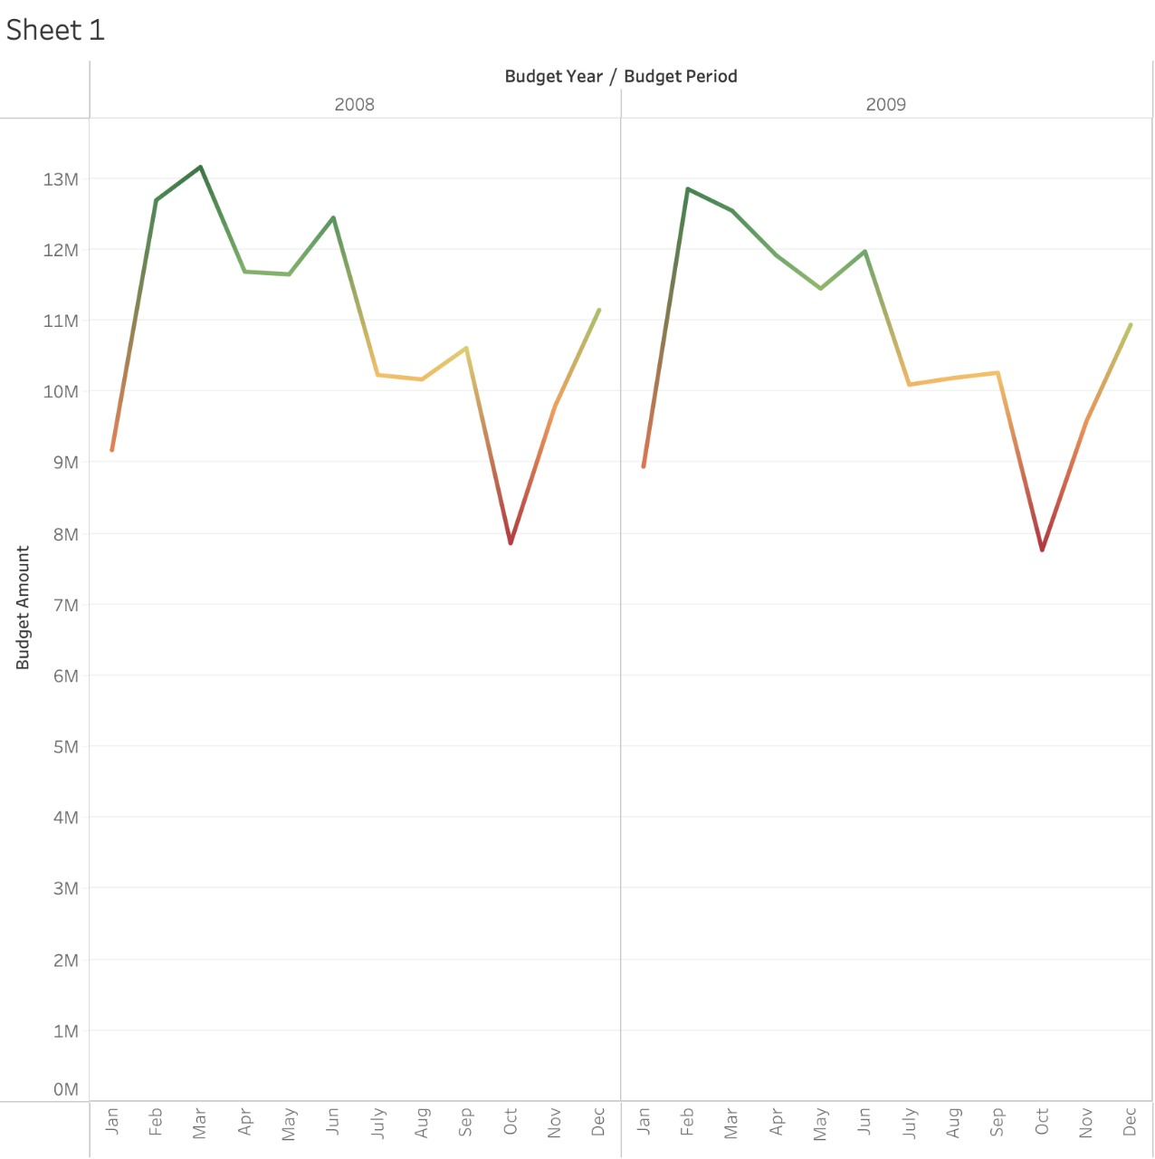
Insight #3
High Customer Budget in May, but Sales are low in May,
Lower Customer Budget in October, but Sales are high in October.

Slide 9

Insight #4
Top 10 Sales Representative as per Sales Margin Amount ->
Best Performing Sales Representative Country Wise :-
Country | Rep ID | Sales Representative | Total Sales Margin
Australia | 149 | Lee Chin | $ 1.75 mil
Canada | 173 | Scott Powell | $ 478,000
Iran | 117 | David Howard | $ 413,000
UK | 118 | David Laychak | $ 965,000
US | 141 | Judy Thurman | $ 15.4 mil
Others | 181 | Stewart Wind | $ 9.7 mil
Best Performer – Judy Thurman

Slide 10
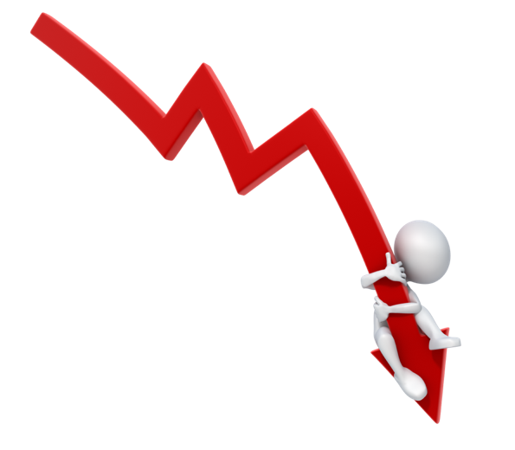
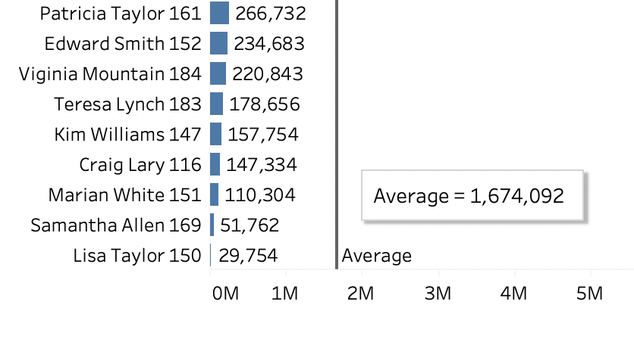
Insight #5
Underperforming Sales representatives :
-Sales Margin Amount average of representatives (for comparison) :
$ 1,600,000 (roughly)
Rep ID | Sales Representative | Total Sales Margin
150 | Lisa Taylor | $ 29,754
169 | Samantha Allen | $ 51,762
151 | Marian White | $ 110,304
---->
Martha Richard (153) - Dropped their sales by 38.08% from 2008 to 2009

Slide 11




Insight #6
Top Product sub-groups in their respective product groups and its Sales Margin figures →
Top Sub-Groups:

Slide 12

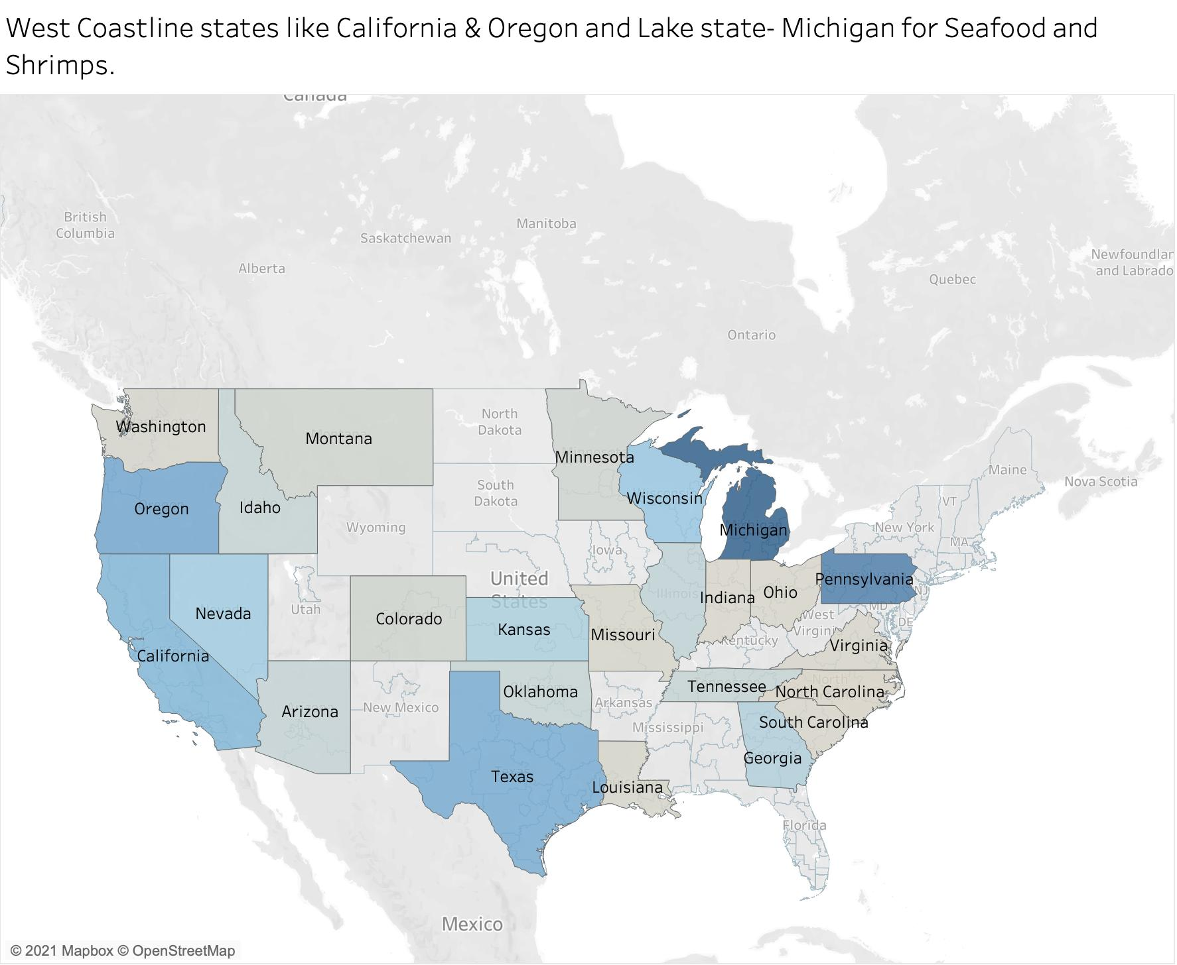
Insight #7
Shrimp sales drop by 75.3% in Q4 despite good turnover for rest of the year.
Suggestive Reasons :-
Seasonal Product
Regionally exclusive product. Reports showing, Shrimp sales are highest in the lake state – Michigan, followed by the West Coast states i.e. California and Oregon.
Similar takeaways for the Seafood category.

Slide 13

Insight #8
Pasta sales have only shot up in Q4 quartile for all the three years.
For US, the Central region has only seen substantial Pasta sales i.e. the likes of Kansas, Missouri & Michigan.
As opposed to contrary, Pasta sales have been overall better Internationally rather than the US.

Slide 14
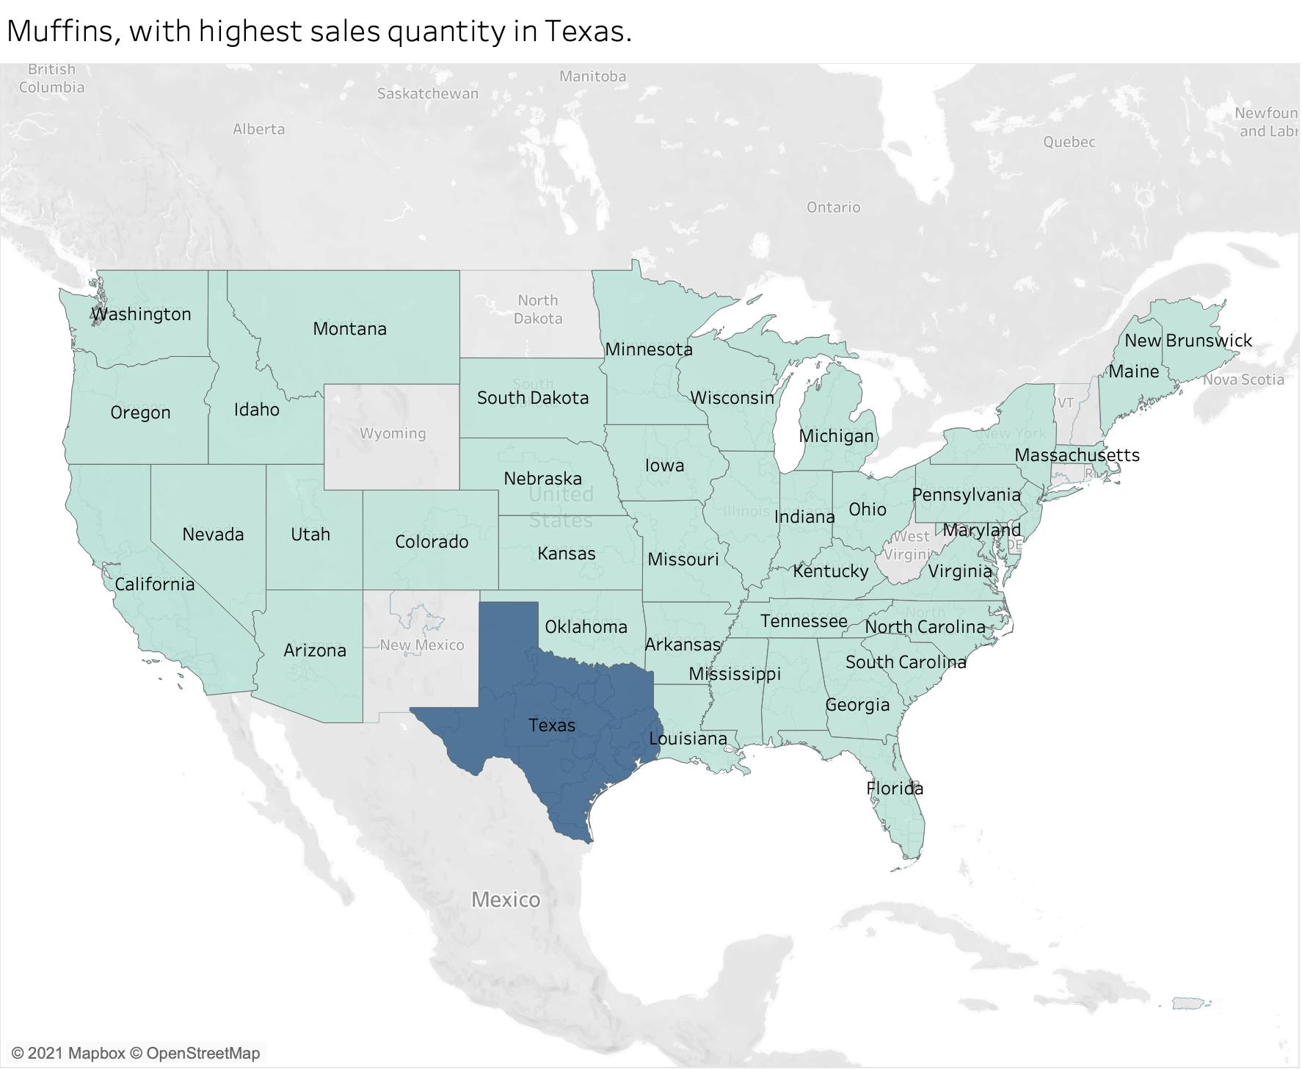


Insight #9
Are Muffins consumed only in Texas? As that’s what suggestive from the sales data.
Chocolate sales have shot up in even quarters (Q2 & Q4).

Slide 15

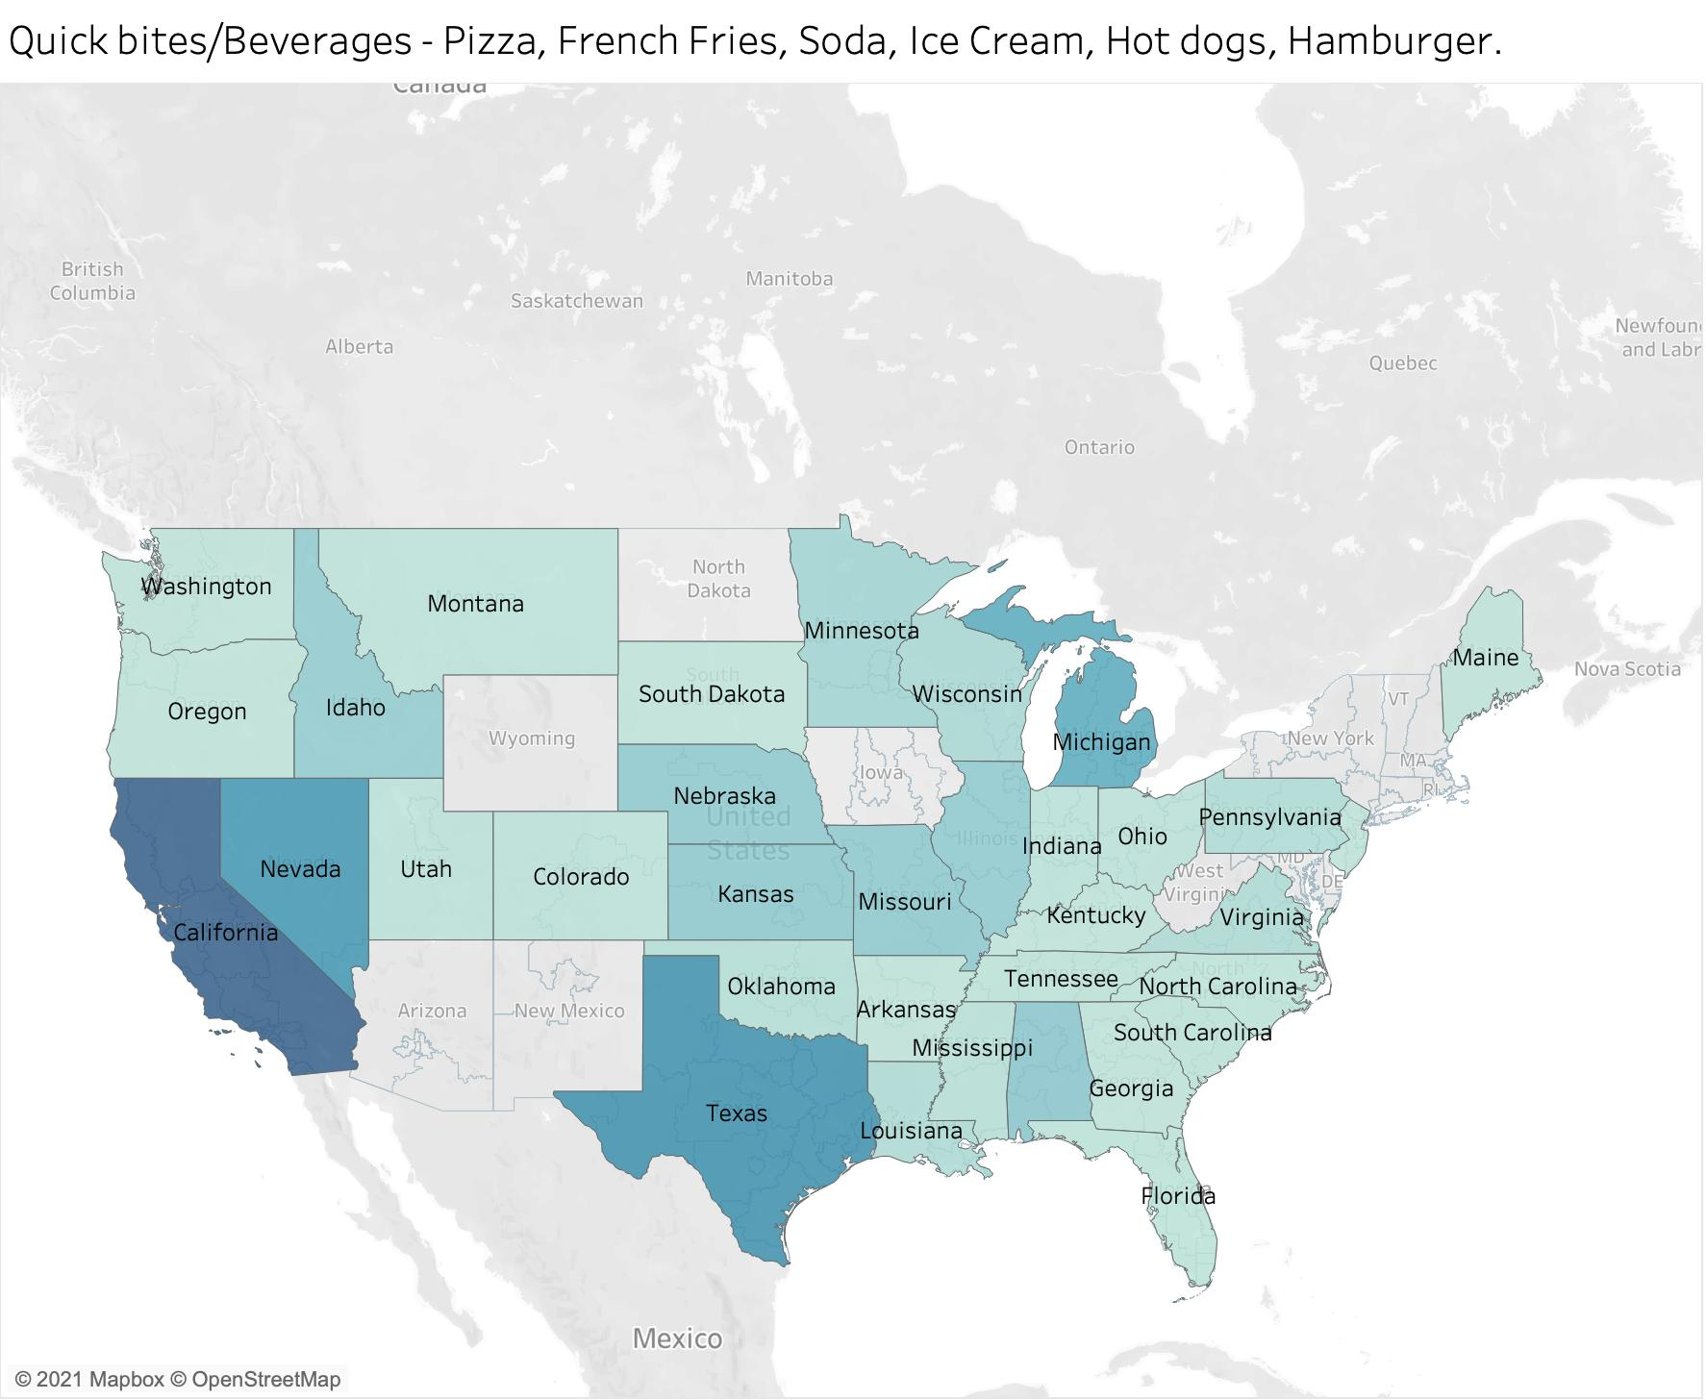
Insight #10
Quick bites or fast food – Pizza, French Fries, Ice Cream, Hot dogs, Hamburger & Soda are overly popular in the California Belt, and in the state of Texas.
These foods are increasingly popular among the young demographics.
Also, the working population prefer the grab’n’go type of foods in this fast paced world.

Slide 16
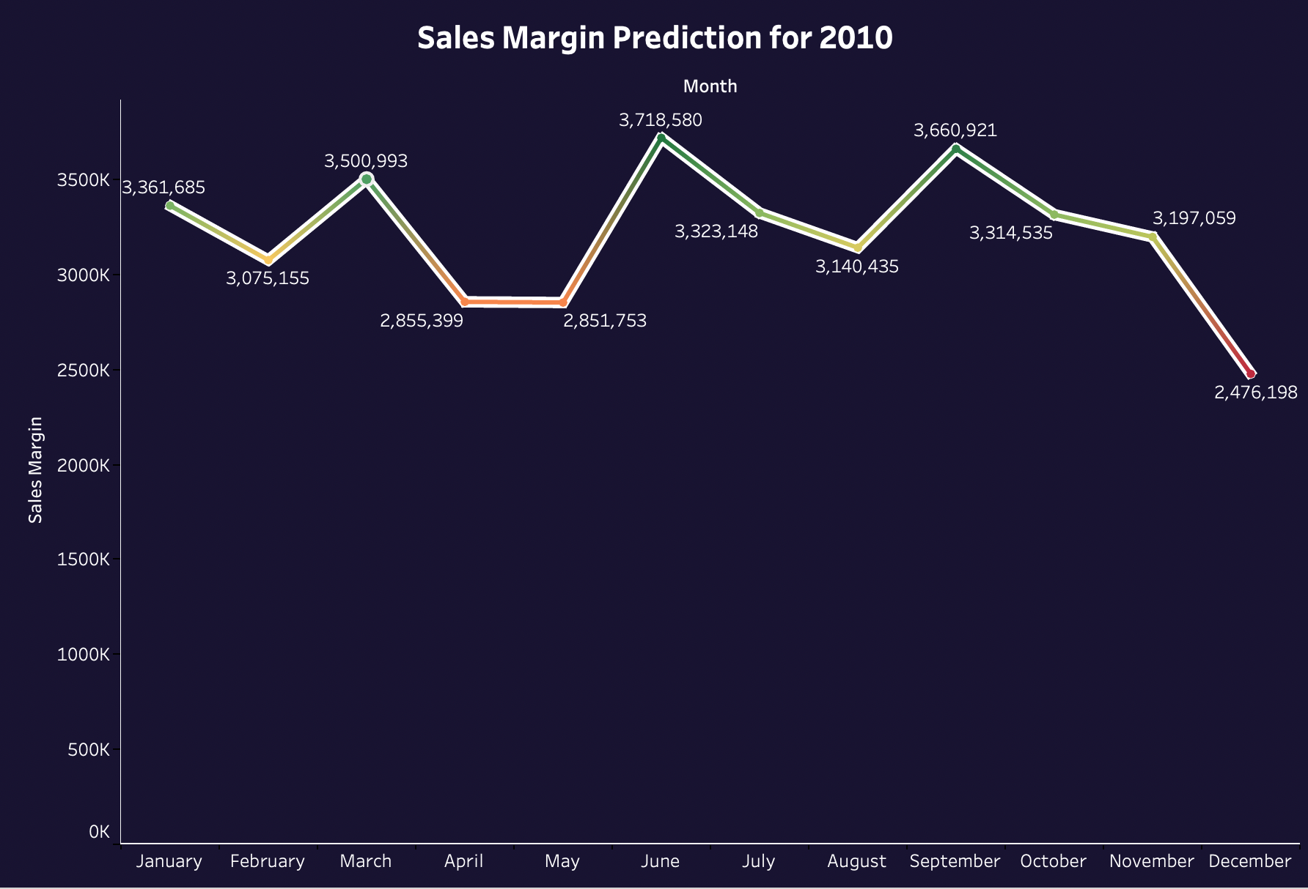
Additional Inputs
Trained the sales margin data for the past three years i.e. 2007, 2008 & 2009 in Python.
Used Random Forrest & XG Boost Regressor and ensembled to fit the data;
And predicted the Sales Margin data for the year 2010.
The data obtained is plotted on Tableau.
Note: This is a prediction result obtained from regression models, so it can differ from exact data. The Python script of the model trained with the predicted outputs are uploaded on the drive link on slide 4.

Slide 17






Tools/Softwares Used
Data Cleaning, Pre-processing & Querying
→
Data Visualization & plots and Dashboard
→
Prediction Model
→

Slide 18
Thank You

